Slide 1
Fourier Transform

Slide 2
Fourier function
What are Signals?
Time domain and frequency domain.
Fourier Transform.
Why transform to the frequency domain?

Slide 3
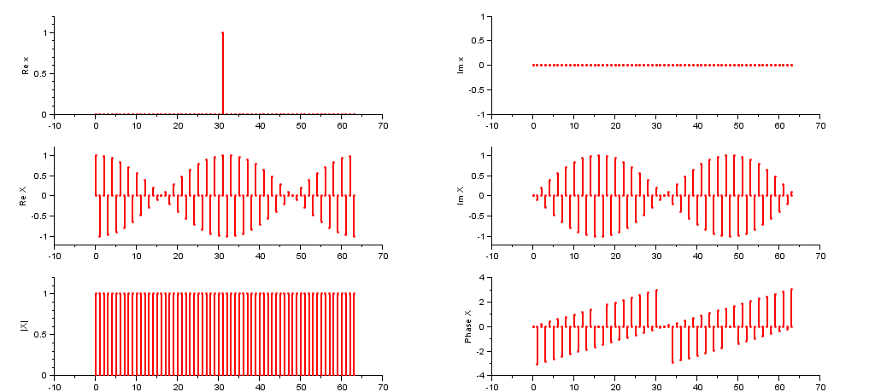
Fourier function
A signal is anything that carries information; these signals change over time or space.
physical phenomenon: pressure, flow, temperature, acceleration, voltage

Slide 4
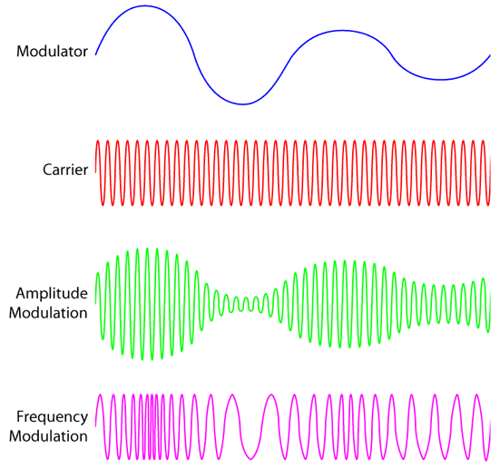
Fourier function
A signal is anything that carries information; these signals change over time or space.

Slide 5
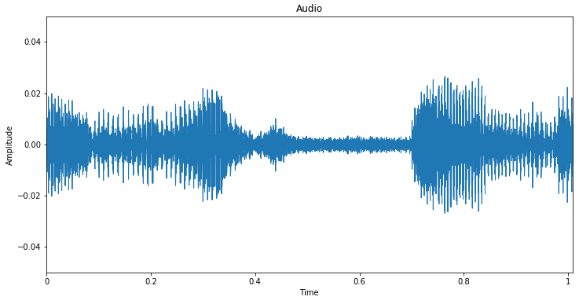
Fourier function
A signal is anything that carries information; these signals change over time or space.
Sound signal (pressure vs. time)

Slide 6
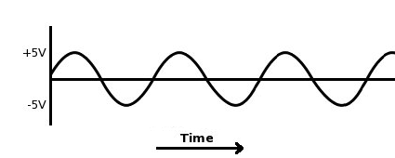
Fourier function
A signal is anything that carries information; these signals change over time or space.
Voltage electrical signal vs. time

Slide 7
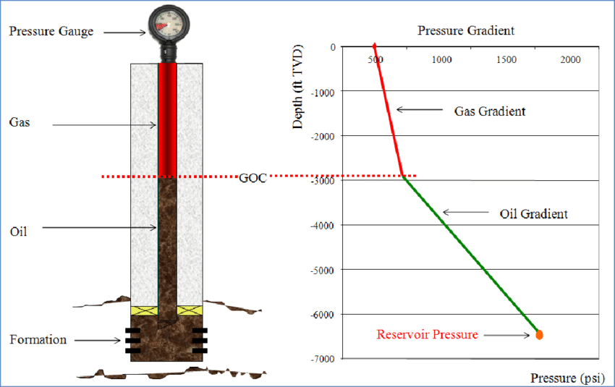
Fourier function
A signal is anything that carries information; these signals change over time or space.
The density and arrangement of the fluids above, as well as their composition (gas, oil, or water). As you go deeper, fluids weigh more on what’s below, so the pressure generally increases. ( In the reservoir ).
Pressure signal ( changes with depth in the oil reservoir)

Slide 8
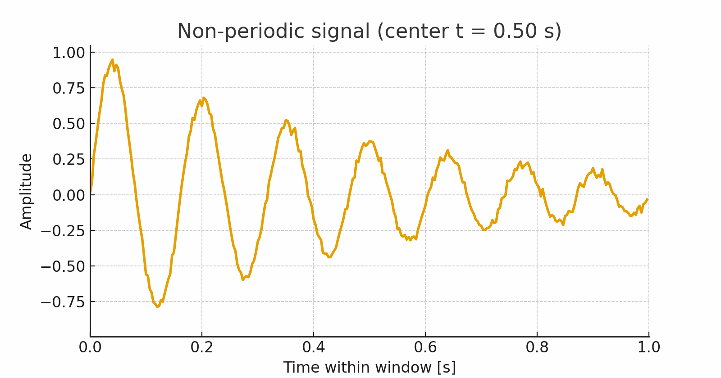
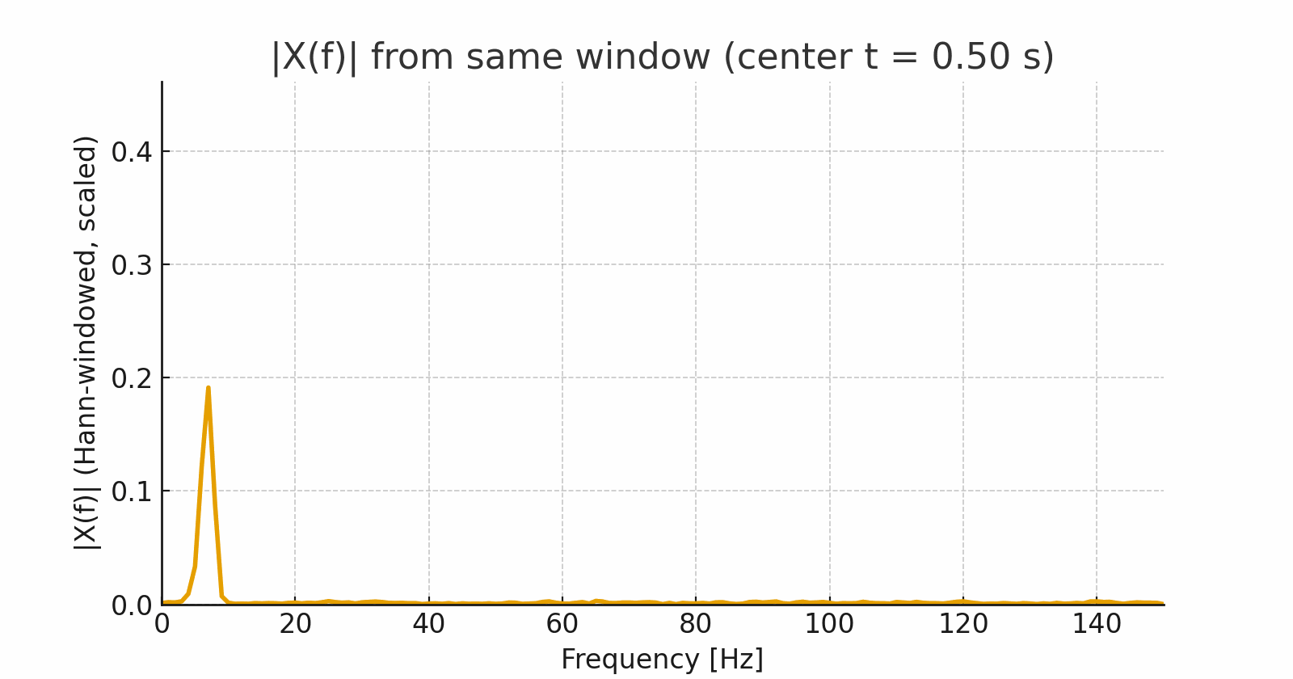
Fourier function
Fourier Transform (FT) is a mathematical technique that transforms a time-domain signal into its frequency-domain representation.
Time domain: amplitude vs the independent variable (time or Space).
Frequency domain: how energy/power is distributed over frequencies.

Slide 9
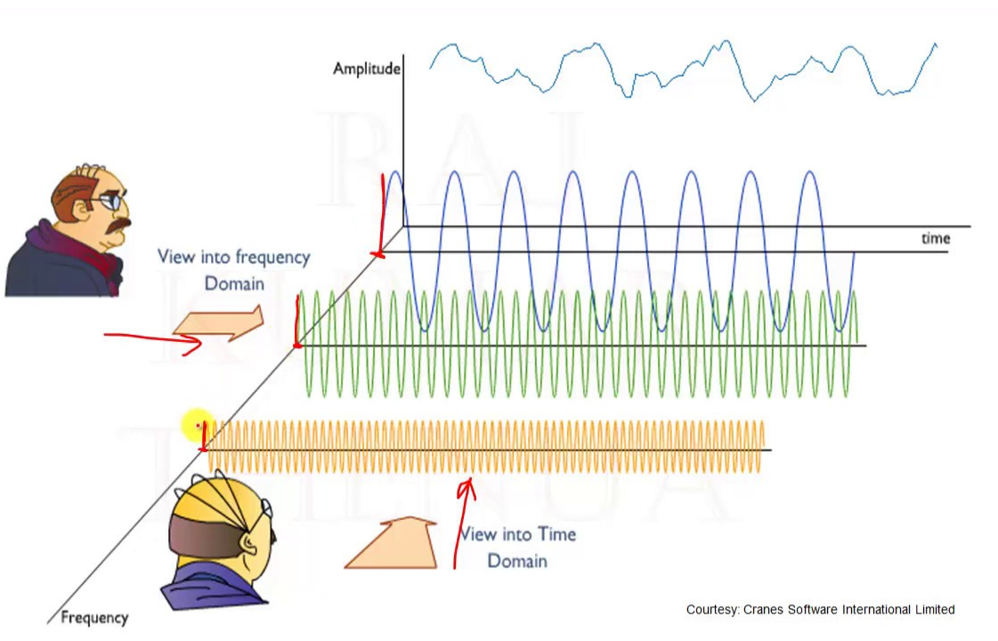
Fourier function
Fourier Transform (FT) is a mathematical technique that transforms a time-domain signal into its frequency-domain representation.
• Time-domain shows signal shape over time.
• Frequency-domain shows which frequencies the signal contains.

Slide 10
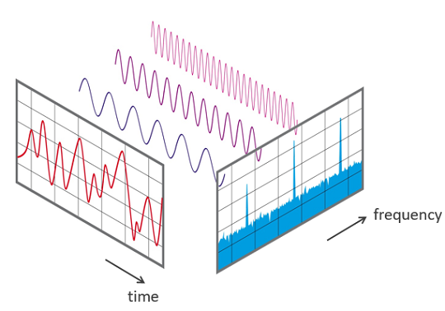
Fourier function
Fourier Transform (FT) is a mathematical technique that transforms a time-domain signal into its frequency-domain representation.

Slide 11
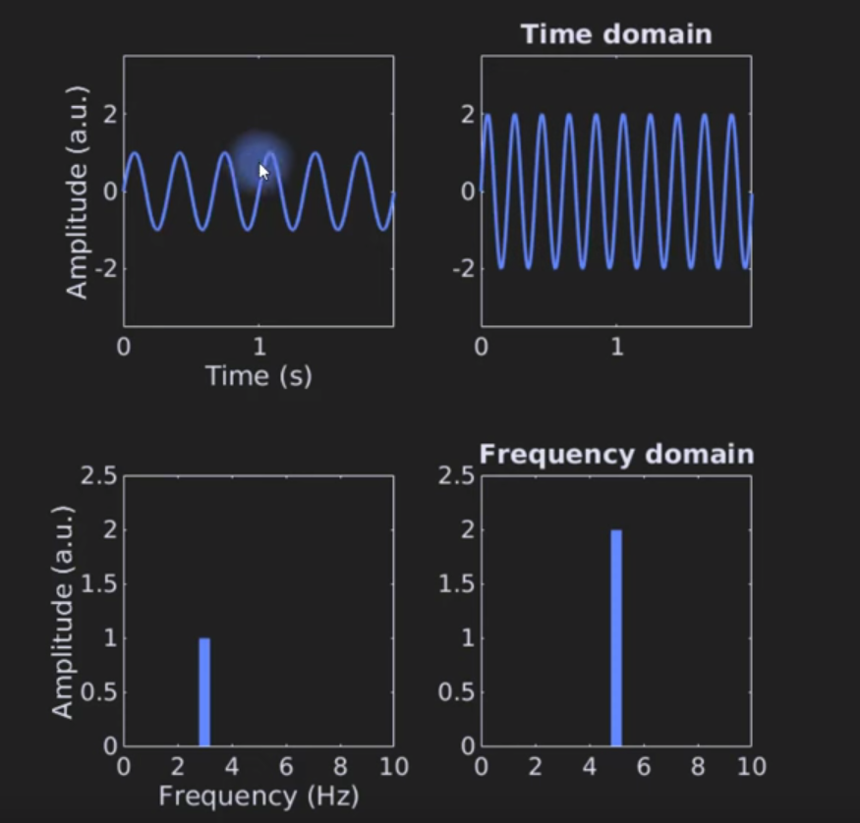
Fourier function
The Fourier Transform provides a way to study the frequency content of these signals.
A periodic function can be expressed as a Fourier series.
many physical signals are non-periodic.
To analyze these, we use the Fourier Transform, which generalizes the idea of the Fourier series to non-periodic signals

Slide 12
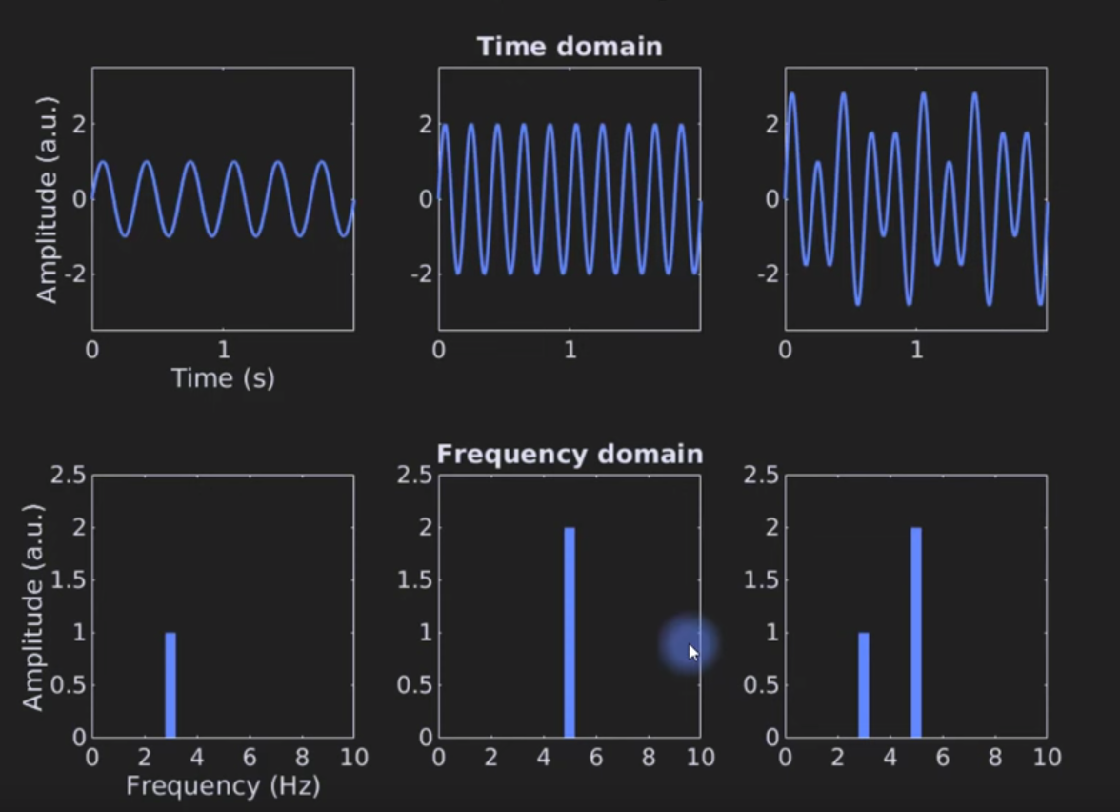
Fourier function

Slide 13
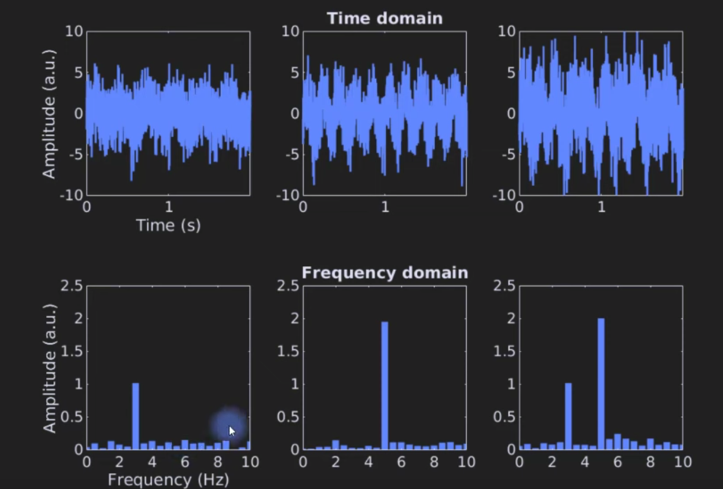
Fourier function

Slide 14
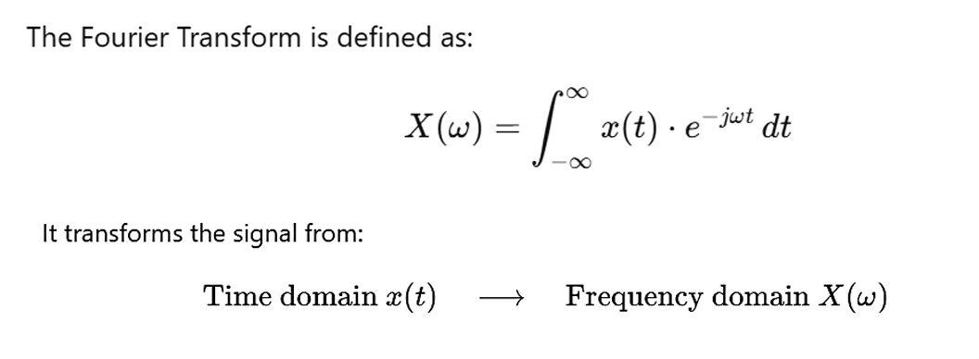
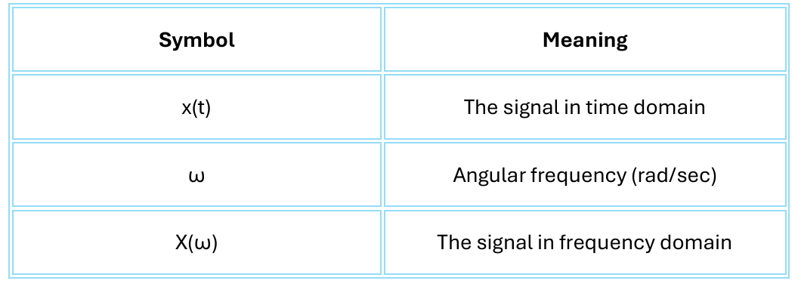
Fourier function

Slide 15
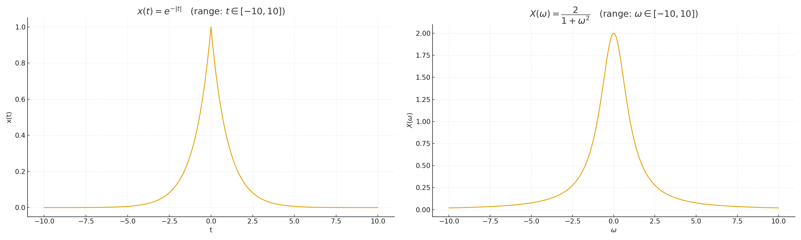
Fourier function

Slide 16
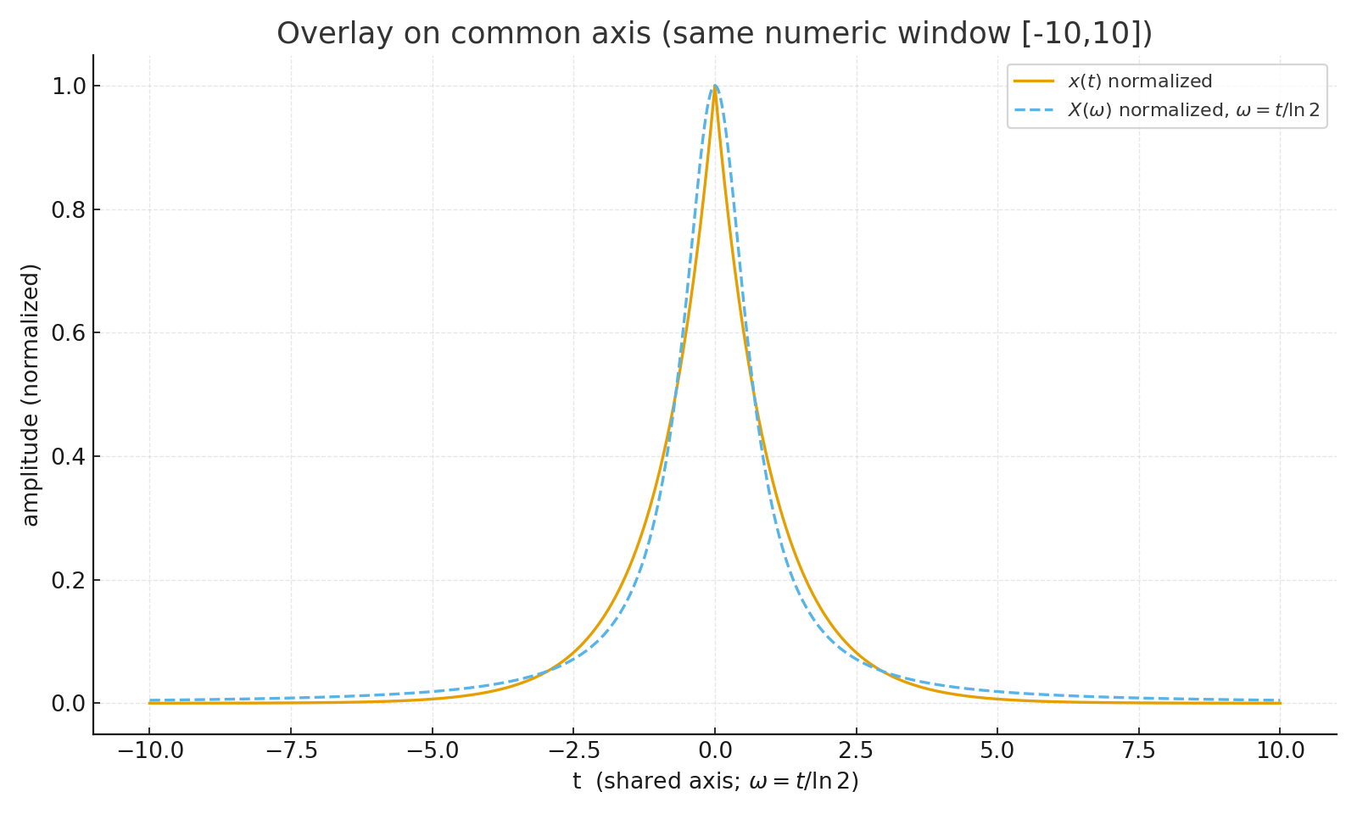
Fourier function

Slide 17
Fourier function

Slide 18
Fourier function

Slide 19
Fourier function

Slide 20
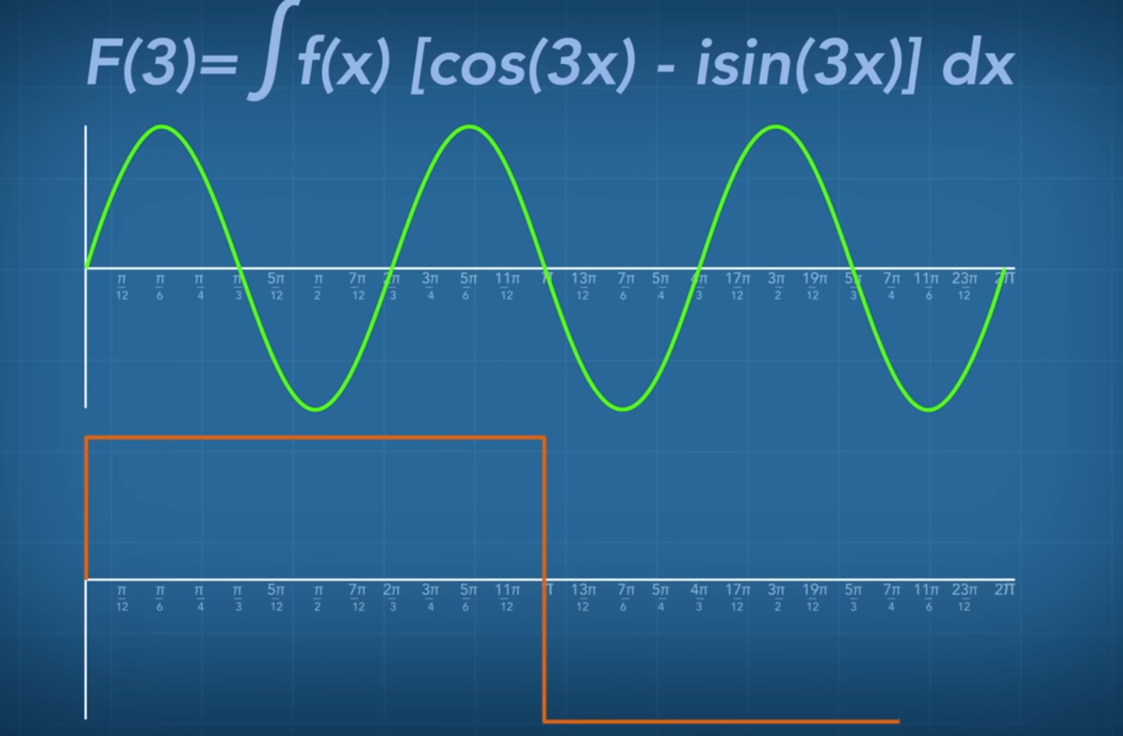
Fourier function

Slide 21
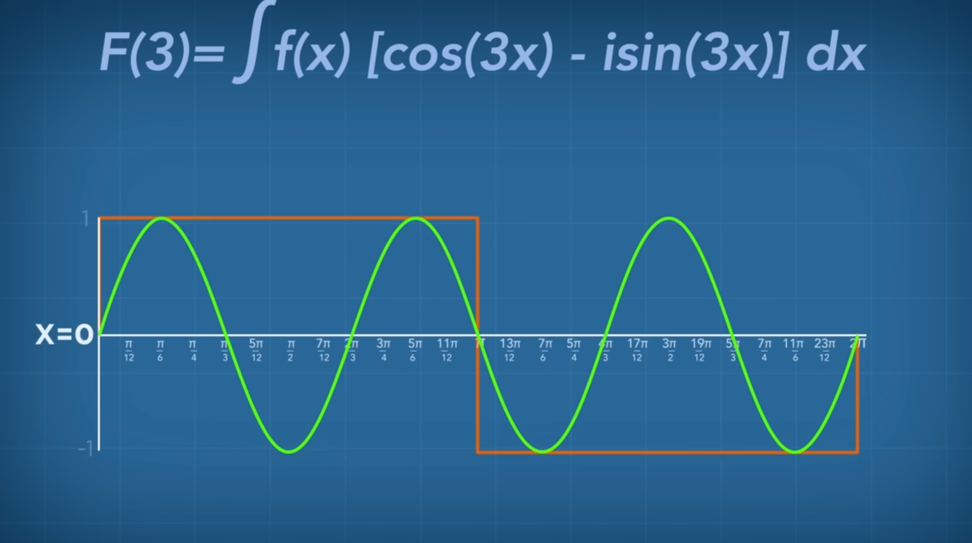
Fourier function

Slide 22
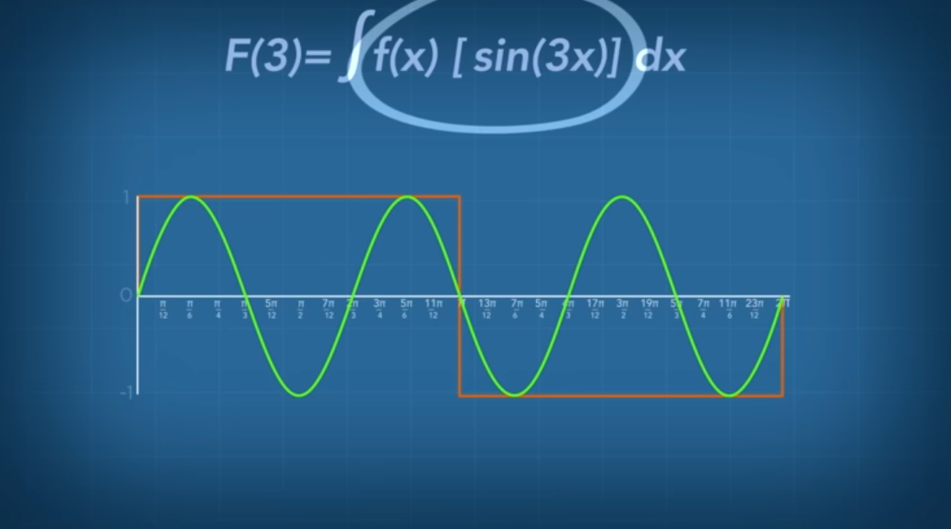
Fourier function

Slide 23
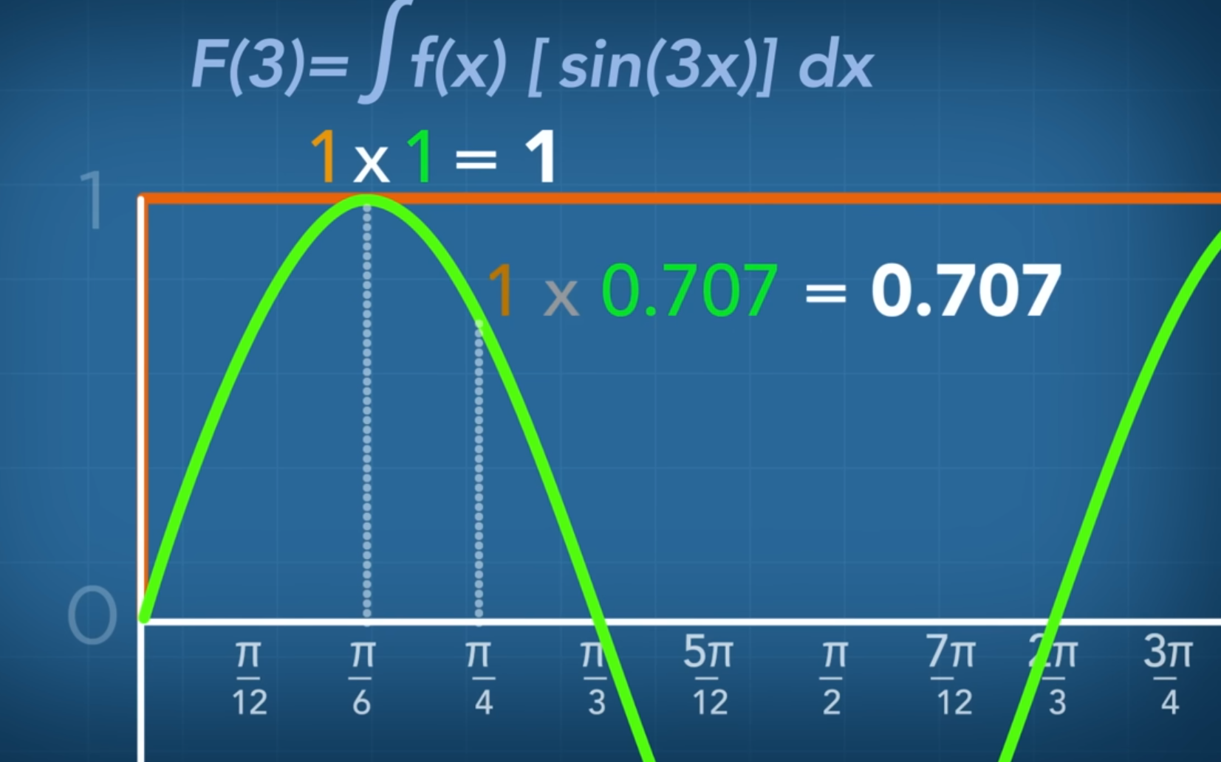
Fourier function

Slide 24
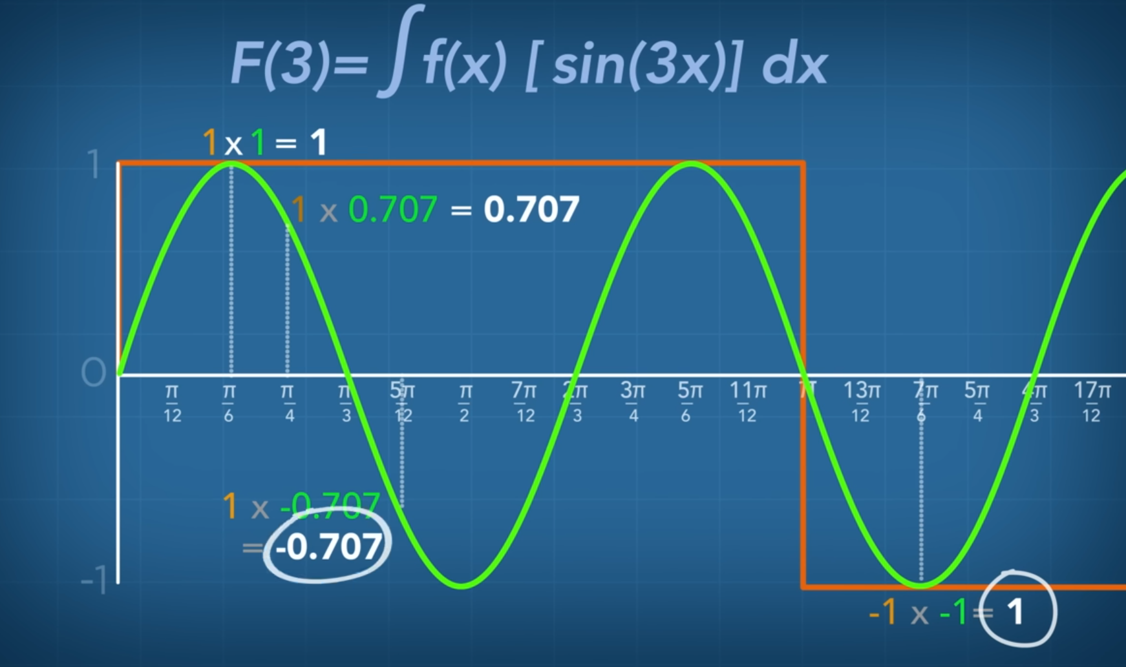
Fourier function

Slide 25
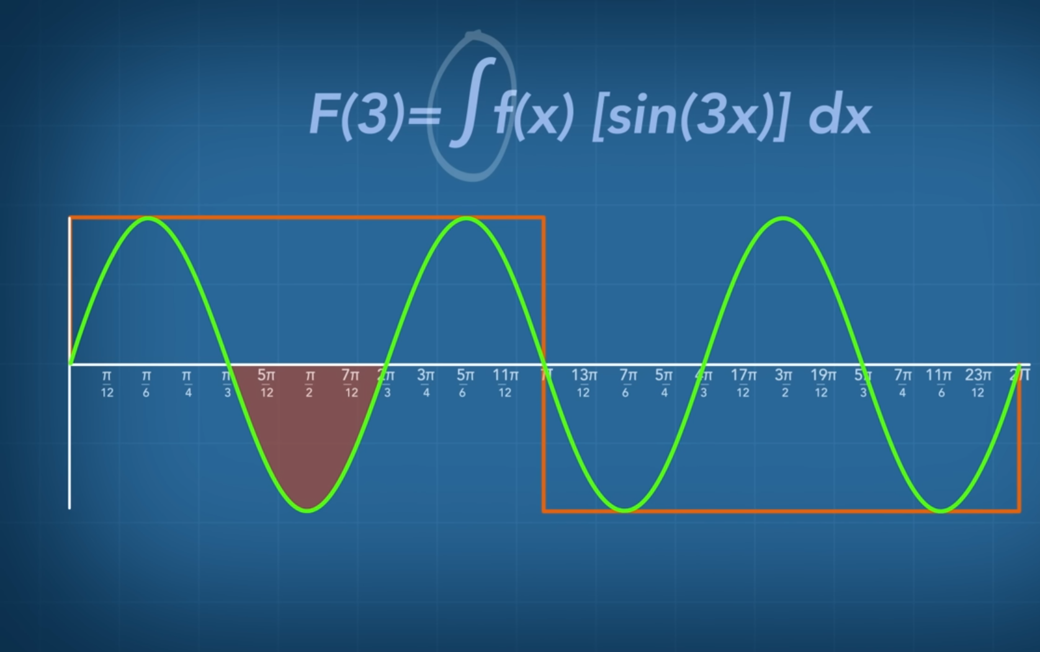
Fourier function

Slide 26




Singal Type
Signals Type
causal signals
Anti-causal signals
C.S. is zero for all negative time
The signal starts at t=0.
There is no effect before t=0
A.C.S. is zero for all positive times.
The signal exists before t=0.
There is no effect after t=0

Slide 27
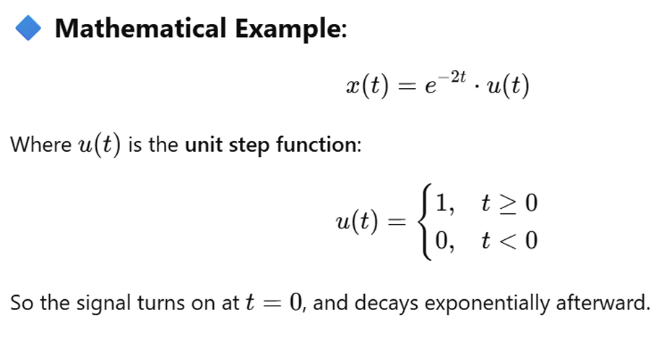
causal signals

Slide 28
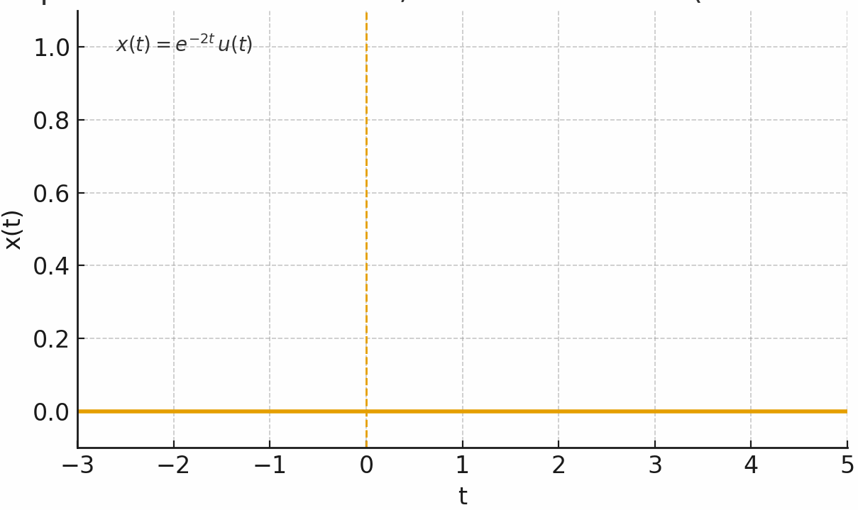
causal signals

Slide 29
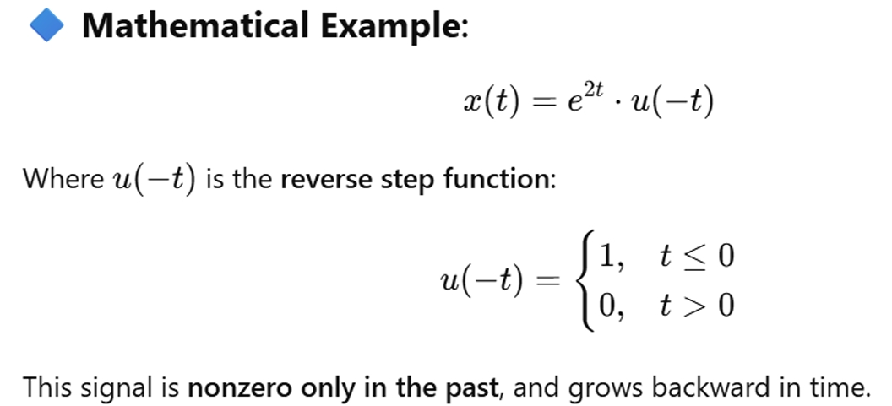
Anti-causal signals

Slide 30
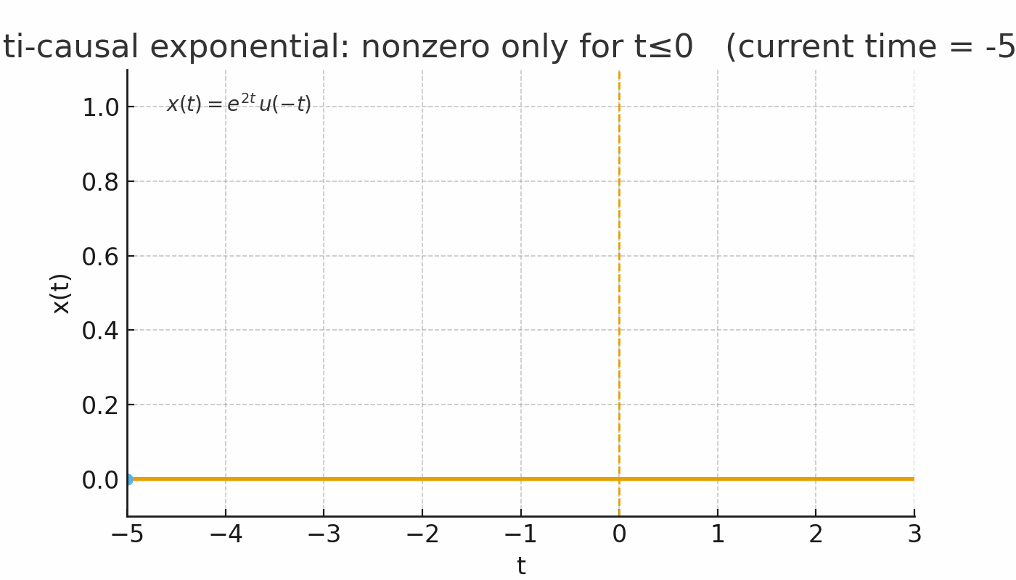
Anti-causal signals

Slide 31
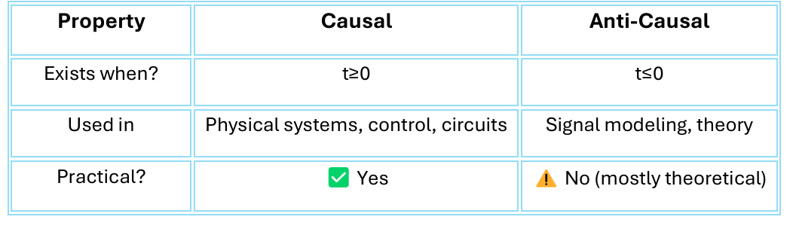
Anti-causal signals

Slide 32
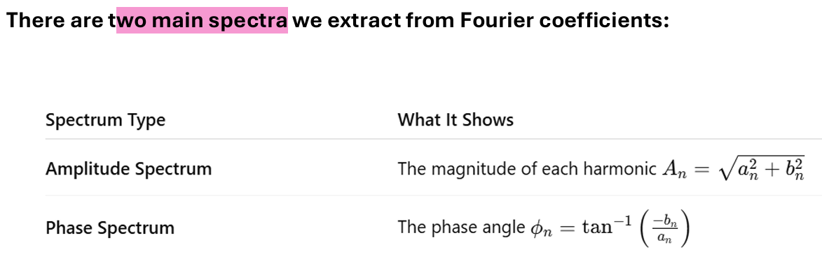
Fourier Spectra
The Fourier spectrum is a plot showing the amplitude and phase of each harmonic (frequency component) in a Fourier series.
It tells us:
• Which frequencies are present in the signal?
• How strong each frequency is (amplitude).
• What is the phase shift of each component (if complex form is used) .

Slide 33






Fourier Spectra

Slide 34
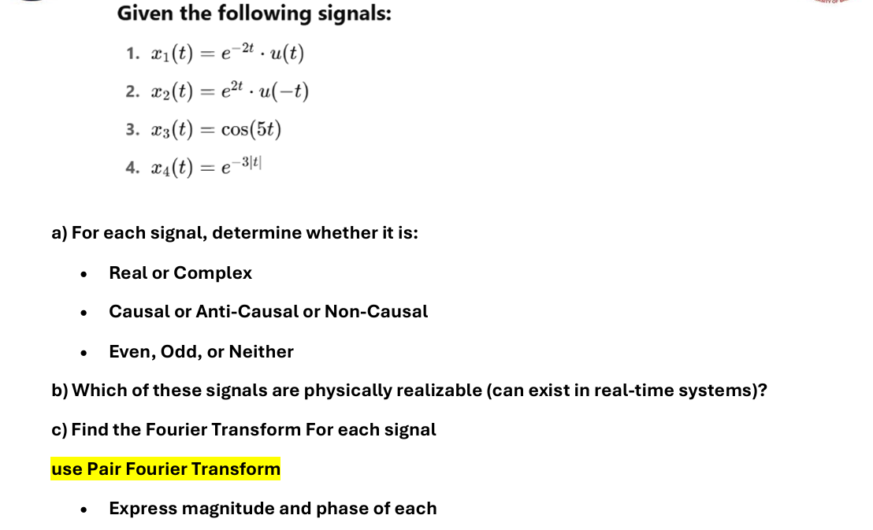
Fourier Spectra

Slide 35
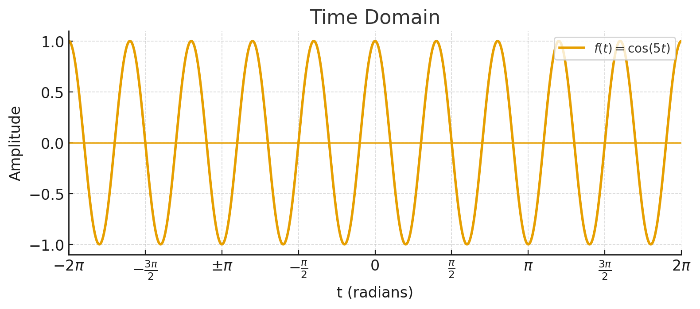
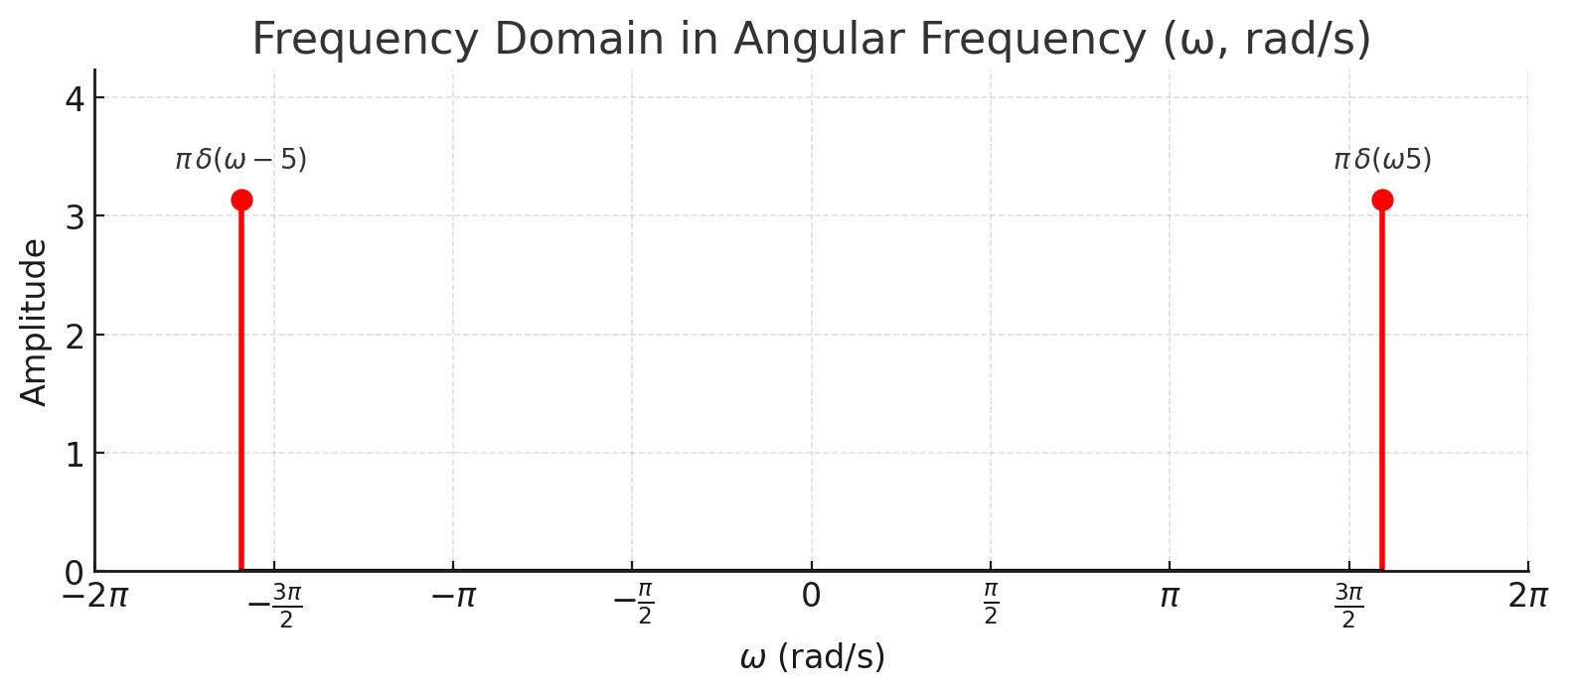
Fourier Spectra

